Slide 1
Funding for Florida Public Schools
Challenges Facing Polk
JASON Pitts, Acting Senior Director, Finance
  Office: 863-457-4704 ext. 706
  Jason.pitts@polk-fl.net

Slide 2
How Does Polk County Compare to other Districts in the Nation?
1
27th Largest District in the nation (# of Students)
Would be the largest school district in 39 states
Funded 995th out of the top 1,000 largest school districts (13,588 districts in the US)
New York and Illinois - $24,000 per student
West Virginia - $15,000 per student
Florida - $7,500 per student

Slide 3
How Does Polk Compare to other Districts in Florida?
2
Polk County is the 7th largest district in the state
Polk County is currently 64th of 67 districts in funding per student
Polk’s average teacher salary is 35th in the state
Polk’s spending on administrative costs is the 3rd lowest in the state
Polk is largest employer in the county with approximately 12,500 employees (not including subs)

Slide 4
Challenges Faced by Polk
3
Polk County is unique as an urban and rural county
Extremely high transportation costs due to size and layout of county (state funding only covers 60% of costs) (example of unfunded/partially funded mandate)
Polk County is larger than the state of Rhode Island
540 buses transport over 51,000 students
60,670 miles travelled each day (24,901)

Slide 5
Florida’s Financing Model
4
Reported in the press as “Dollars per Student”
Called the FEFP – Florida Education Financing Program
To receive state FUNDING districts must use Required Local Effort
When designed, it attempted to equalize funding across districts
Funding is primarily property tax and sales tax

Slide 6
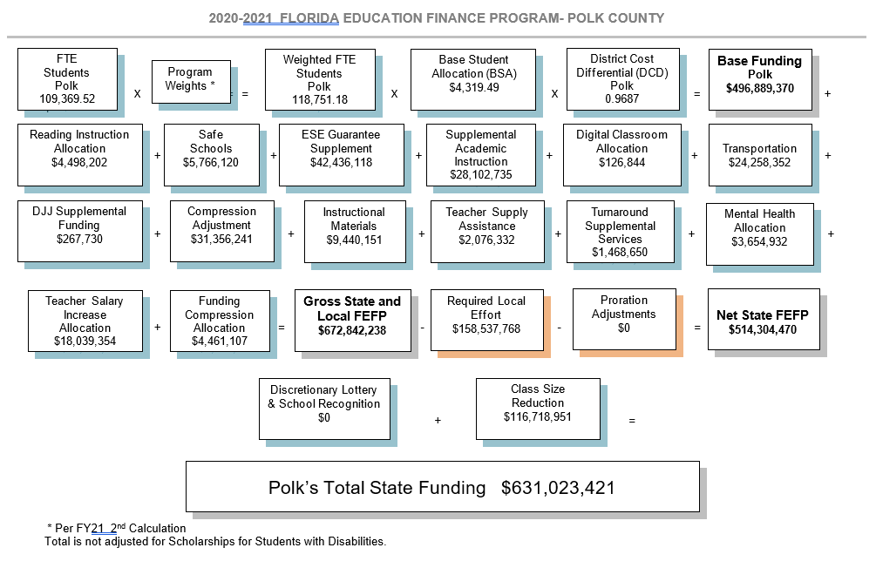

Slide 7
Transportation Funding vs. Expense
Partial/Unfunded Mandates
6
Expense
Funding

Slide 8
10-year loss
$261,510,708

Slide 9
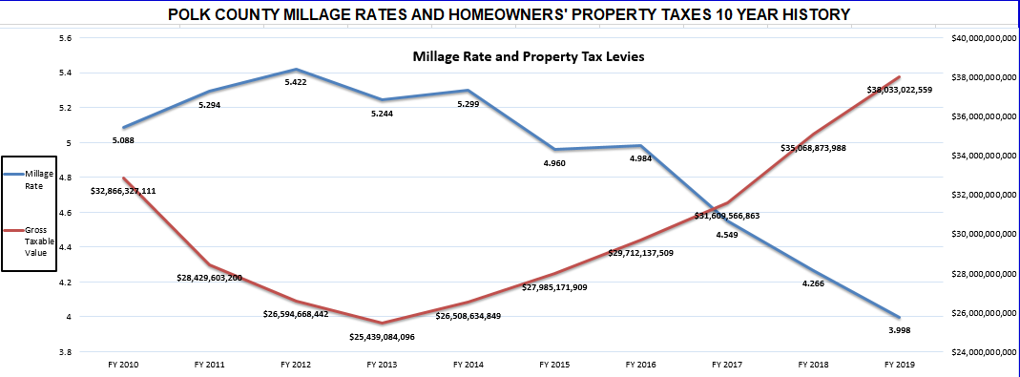

Slide 10
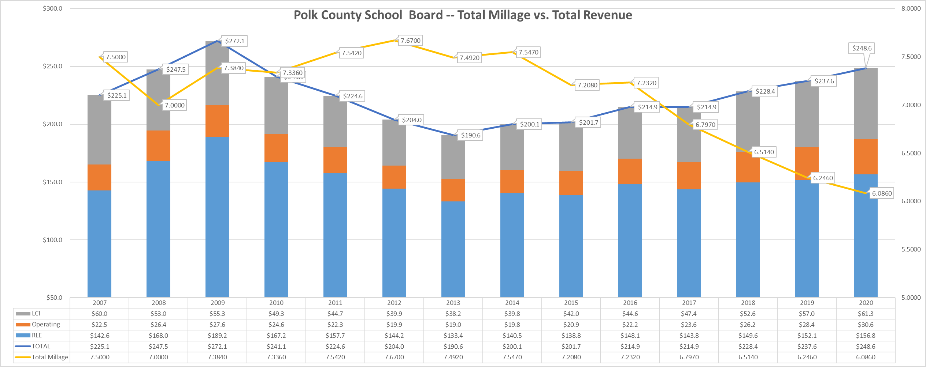
Millage Rate Rollback

Slide 11
What if the millage rate was held constant at the 2011-12 rate instead of rolling back?
Fiscal Year | Total Millage | Taxable Value | Tax Revenue | Constant Mills | Tax Revenue | Additional Revenue
2006-07 | 7.500 | $ 30,014,236,274 | $ 225,106,772
2007-08 | 7.000 | $ 35,357,641,301 | $ 247,503,489
2008-09 | 7.384 | $ 36,847,154,973 | $ 272,079,392
2009-10 | 7.336 | $ 32,866,327,111 | $ 241,107,376
2010-11 | 7.542 | $ 29,784,001,684 | $ 224,630,941
2011-12 | 7.670 | $ 26,594,668,442 | $ 203,981,107
2012-13 | 7.492 | $ 25,439,084,096 | $ 190,589,618 | 7.670 | $ 195,117,775 | $ 4,528,157
2013-14 | 7.547 | $ 26,508,634,849 | $ 200,060,667 | 7.670 | $ 203,321,229 | $ 3,260,562
2014-15 | 7.208 | $ 27,985,171,909 | $ 201,717,119 | 7.670 | $ 214,646,269 | $ 12,929,149
2015-16 | 7.232 | $ 29,712,137,509 | $ 214,878,178 | 7.670 | $ 227,892,095 | $ 13,013,916
2016-17 | 6.797 | $ 31,609,566,863 | $ 214,850,226 | 7.670 | $ 242,445,378 | $ 27,595,152
2017-18 | 6.514 | $ 35,068,873,988 | $ 228,438,645 | 7.670 | $ 268,978,263 | $ 40,539,618
2018-19 | 6.246 | $ 38,033,022,559 | $ 237,554,259 | 7.670 | $ 291,713,283 | $ 54,159,024
2019-20 | 6.086 | $ 40,852,038,592 | $ 248,625,507 | 7.670 | $ 313,335,136 | $ 64,709,629
Total additional revenue if millage was constant instead of "rolled-back" from 2013-2020 = |  |  |  |  |  | $ 220,735,208

Slide 12
How has the School District’s total millage rate affected the average homeowner?
For a homeowner who purchased home in 2007 and qualified for homestead exemption -- School Taxes paid in 2008 = $1,255.63 School Taxes paid in 2020 = $1,017.57
 | 2007 | 2008 | 2009 | 2010 | 2011 | 2012 | 2013 | 2014 | 2015 | 2016 | 2017 | 2018 | 2019 | 2020
Market Value | $ 175,000.00 | $ 206,155.08 | $214,839.79 | $191,629.31 | $ 173,657.60 | $155,061.98 | $148,324.27 | $154,560.36 | $163,169.41 | $ 173,238.59 | $ 184,301.68 | $204,471.40 | $ 221,754.07 | $ 238,190.53
Assessed Value | $ 175,000.00 | $ 179,375.00 | $179,554.38 | $184,402.34 | $ 187,168.38 | $177,213.69 | $148,324.27 | $150,549.14 | $151,753.53 | $ 152,815.80 | $ 156,024.93 | $159,301.46 | $ 162,328.19 | $ 167,198.03
Save our Homes |  | $ 26,780.08 | $ 35,285.41 | $ 7,226.96 | $ - | $ - | $ - | $ 4,011.22 | $ 11,415.88 | $ 20,422.79 | $ 28,276.75 | $ 45,169.94 | $ 59,425.88 | $ 70,992.50
Taxes Paid |  | $ 1,255.63 | $ 1,325.83 | $ 1,352.78 | $ 1,411.62 | $ 1,359.23 | $ 1,111.25 | $ 1,136.19 | $ 1,093.84 | $ 1,105.16 | $ 1,060.50 | $ 1,037.69 | $ 1,013.90 | $ 1,017.57

Slide 13
Polk County School Board Budget
FY2020-2021
Total Adopted Budget - $1,925,764,102
General Fund - $1.005 BILLION
Special Revenue (Title funds, food service, other grants) - $188 million
Debt Service - $62 million
Capital - $507 million (typically $182 million – artificially high due to bonding in 2020)
Internal Services (Self-Insured Funds) - $141 million
Agency Accounts (Internal) - $23 million

Slide 14
Where does General Fund dollars go?
(Ending 2019-2020)
General Fund Expenditures ( In Millions)
 | Salaries and Benefits | $ 604 | 70.6%
 | Contracted Services | $ 174 | 20.3%
 | Energy Services | $ 14 | 1.6%
 | Materials and Supplies | $ 22 | 2.6%
 | Capital Expenditures | $ 35 | 4.1%
 | Other | $ 7 | 0.8%
 | Total | $ 856
 | Passthrough to Charter Schools = $120 million
 | Salaries and Benefits | $ 604 | 82.0%
 | Contracted Services | $ 54 | 7.3%
 | Energy Services | $ 14 | 1.9%
 | Materials and Supplies | $ 22 | 3.0%
 | Capital Outlay | $ 35 | 4.8%
 | Other | $ 7 | 1.0%
 | Total | $ 736
POLK GENERAL FUND BUDGET W/O CHARTER SCHOOL PASSTHROUGH

Slide 16
General Fund Financial Health – Fund Balance
Board Policy – 5% (unassigned/assigned)
State minimum – 3%
State emergency intervention – 2%
Standard government agency benchmark – 60 days or 15%

Slide 17
Current Issues Facing Polk Schools

Slide 18
Budget
Loss of Students (FTE) and Loss of Revenue
  Polk county has not seen a decline in students from the previous year for at least 25 years
  Fund Balance
  Legislative initiatives
  Expanding voucher programs
  Control of Federal Stimulus dollars

Slide 19
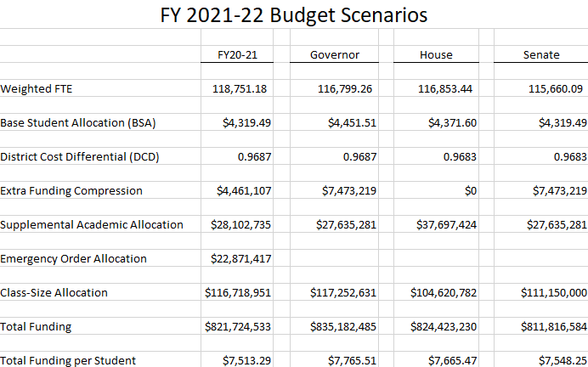

Slide 20
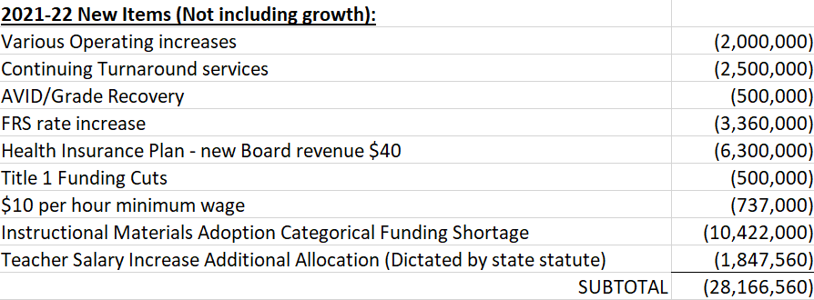
Expected Cost increases for FY 2021-22

Slide 21
THANK YOU, DISTRICT DAC Committee Members!
*The information in this presentation is valid as of 4/15/2021.

